Slide 1






Predicting CO2 savings from renewables​
Dominika Filipiak, Emilia Velikova, Danu Cislaru, Kacper Grobelny, Filip Bičanić​

Slide 2
Why Do CO₂ Savings from Renewables Matter?​
Energy production is one of the largest sources of global CO₂ emissions
​
Fossil fuels significantly contribute to climate change
Renewable energy reduces emissions by replacing fossil fuel generation ​
​
Notes:
This project studies the relationship between electricity production and carbon intensity. The main idea is to see how different energy sources such as coal, gas, hydro, wind, solar, and nuclear energy influence the amount of CO2 emitted per unit of electricity. I used data analysis and machine learning to build a model that predicts carbon intensity and helps explain which energy sources matter the most.
The problem I wanted to solve is important because electricity production is one of the biggest contributors to greenhouse gas emissions. Some energy sources produce much more CO2 than others, so if we understand how the energy mix changes carbon intensity, we can better understand the environmental impact of a region. The question behind the project is simple: can we use the electricity mix to estimate carbon intensity accurately?

Slide 3
Project Goal
Predict CO emissions per kWh using machine learning
Analyze how different energy sources affect emissions
Identify which energy sources are the most impactful
Notes:
This project studies the relationship between electricity production and carbon intensity. The main idea is to see how different energy sources such as coal, gas, hydro, wind, solar, and nuclear energy influence the amount of CO2 emitted per unit of electricity. I used data analysis and machine learning to build a model that predicts carbon intensity and helps explain which energy sources matter the most.
The problem I wanted to solve is important because electricity production is one of the biggest contributors to greenhouse gas emissions. Some energy sources produce much more CO2 than others, so if we understand how the energy mix changes carbon intensity, we can better understand the environmental impact of a region. The question behind the project is simple: can we use the electricity mix to estimate carbon intensity accurately?

Slide 4






Research Objective​
Quantify how much CO₂ emissions are avoided by renewable energy production ​
Analyze the relationship between renewable share (%) and CO₂ savings
Evaluate how increasing renewable energy impacts emission reduction ​
Compare impact across countries and over time​

Slide 5

Dataset overview​
The global dataset covers all countries around the world​
Time range: last 10 years ​ [2016-2025]
Contains energy production by source: ​coal, gas, oil, hydro, nuclear, solar, wind and biofuel ​
Includes renewable share (%) and carbon intensity (CO₂ per kWh)​

Slide 6
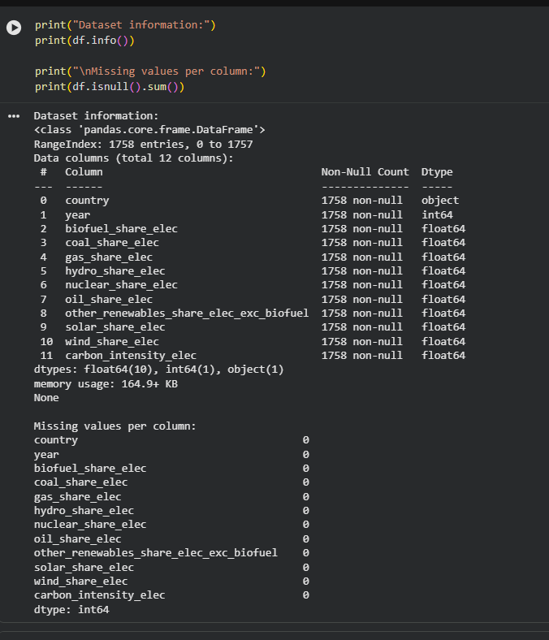
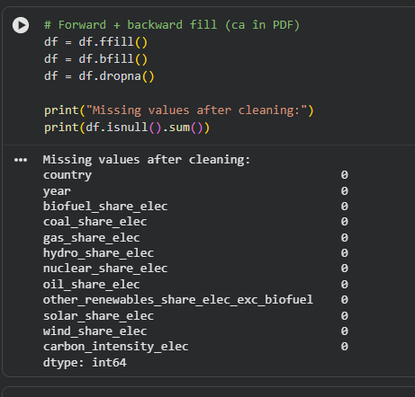
Dataset overview and preprocessing​

Slide 7
How We Approached The Problem
Cleaned and prepared the dataset
Created prediction target (next-year emissions)
Split data into training and testing sets
Trained a Random Forest model
Evaluated performance using multiple metrics

Slide 8
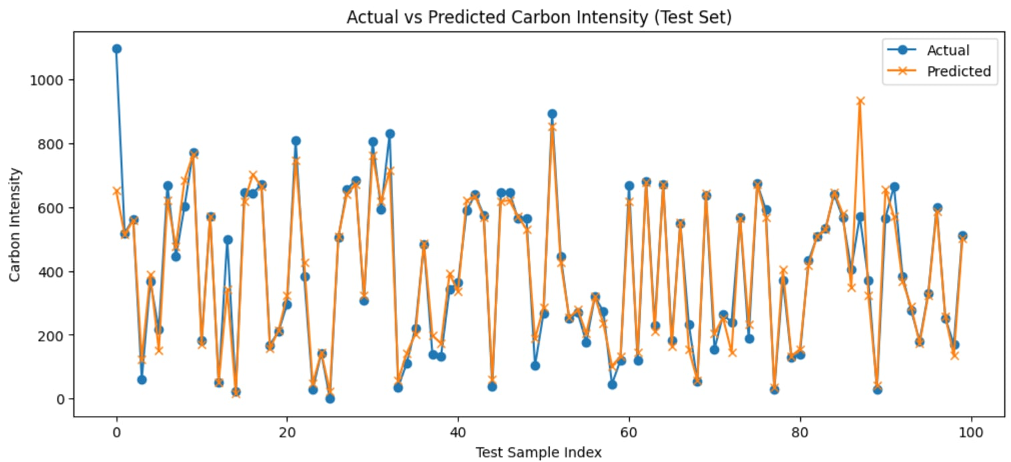
Model Predictions:
Actual vs Predicted CO₂ Emissions

Slide 9
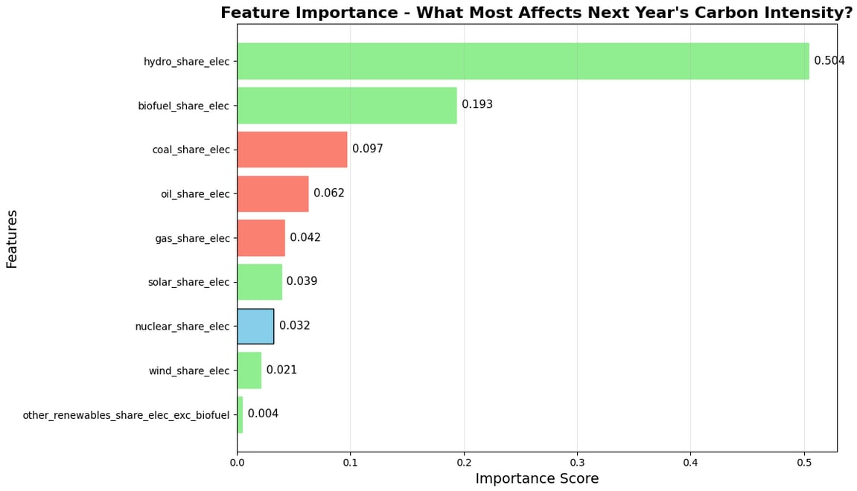
What Factors Influence CO₂ Emissions the Most?

Slide 10
THANK YOU FOR YOUR ATTENTION!

